Slide 1
POWER-AID
GROUP 6
FALL 2011
GROUP MEMBERS:
Chris Diller
Arman Murat
Christian Aranha
Kurt Riecken

Slide 2
Project Description
Power-Aid is a home power monitoring system that allows a homeowner to keep track of appliance power consumption as well as monitoring and regulating emergency power in times of utility power loss.
Our Design Content:
Provide by Homeowner:
Power Strip Modules
Generator Power Monitoring Module
Automatic Transfer Switch Module
User Touch Screen Interface
Wireless communications
Home Generator (any size)
Automatic Transfer Switch

Slide 3
Motivation
Loss of power during natural disasters
Hassle of flipping circuit breakers on/off
Safeguarding of expensive home generator
Ease of use for the inexperienced user
Gives homeowner insight to individual appliance power consumption and how to conserve energy usage.

Slide 4
Goal and Objectives
Design a user-friendly touch screen interface for the user to interact with the system.
Design compact power strip modules to appeal to the aesthetics of the users home.
Design the power strip modules for easy expansion to current system.
Make the home owner aware of energy consumption and conservation

Slide 5
Specifications
Measure current up to 15A (standard home circuit breaker size).
Measure up to 120V (+/- 5 volts for utility fluctuations).
Calculate power consumption with +/- 5% error.
Ability to add up to 20 power strip modules to the system.
Software will automatically warn the user when the generator is outputting 90% of its total power capacity.
Wireless communication range of modules shall be at least 100 feet from touchscreen controller to accommodate average size house.
ADC that is at least 10 bits wide for 1024 steps of resolution in power calculations.
Send data every 5 seconds and enter sleep mode in between transmissions.

Slide 6
System Block Diagram
TOUCH
SCREEN
POWER STRIP MODULE
GENERATOR
ATS
DISPLAY
POWER
MEASUREMENT
ATS
CONTROL
POWER
MEASUREMENT
RELAY
MAIN
PROCESSOR
MICRO-
CONTROLLER
MICRO-
CONTROLLER
MICRO-
CONTROLLER
WIRELESS
RADIO
WIRELESS
RADIO
WIRELESS
RADIO
WIRELESS
RADIO

Slide 7
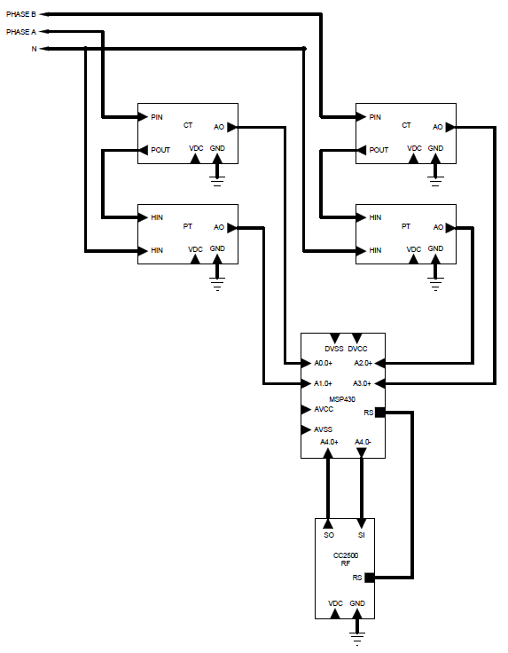
Generator Module Block Diagram
Contents of Generator Module
(2) Current Transformers
(2) Potential Transformers
MSP430AFE253
TI CC2500 RF Transceiver

Slide 8
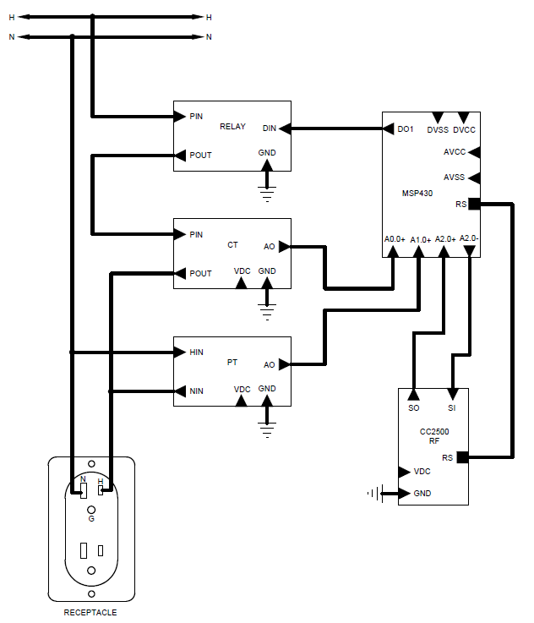
Power Strip Module Block Diagram
Contents of Power Strip
Solid State Relay
Current Transformer
Potential Transformer
MSP430AFE253
TI CC2500 RF Transceiver
15A duplex receptacle

Slide 9
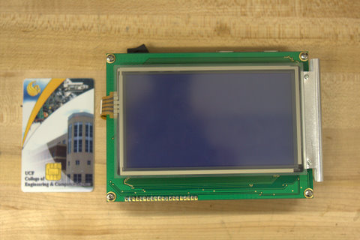
Qscreen Controller
QSCREEN CONTROLLER
Programmable in C or Forth languages.
GUI development software for easy implementation of touch screen display interface.
4.8” diagonal viewing area.
Flash – 354KB
RAM – 509KB
EEPROM – 320B
8 Channel 8-bit A/D at up to 100 Kbps, 0-5 V input
Expandable memory capabilities if on board memory is not sufficient.
Only external part needed is wireless communications.

Slide 10
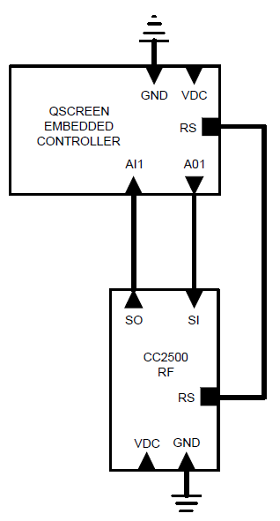
Touch Screen Block Diagram
Qscreen Embedded Controller needs a wireless interface to communicate with the rest of the system.
TI CC2500 RF Transceiver will be utilized using Zigbee communication protocol.
We chose TI wireless because of the compatibility with the MSP430 and also the simplicity of the Zigbee protocol compared to other wireless options.

Slide 11
Software Flowchart
Qscreen
Receive
Measurement
Store Data
In Memory
Calculations/
Update Screen
Yes
Execute
Routine
No
Move To
Next Module
Check for
Touch Screen
Interrupts

Slide 12
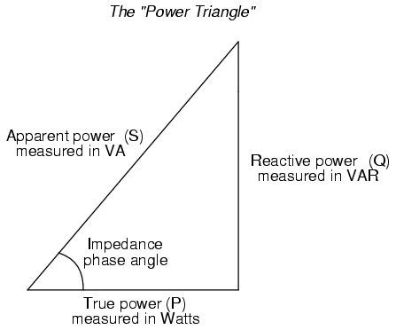
POWER MEASUREMENT
Power companies charge for the real power consumption.
Real power, is the cosine of Apparent Power ( P = V * I * cosƟ )
In order to measure power we needed to build a circuit which would accurately measure the three unknowns of the power equation V, I and Ɵ.
Notes:
Power companies charge for the real power consumption.
Real power, is the cosine of Apparent Power ( P = V * I * cosƟ )
In order to measure power we needed to build which would accurately measure the three unknowns of the power equation V, I and Ɵ.

Slide 13
Different Current Measuring Alternatives
Current Shunt
It’s a resistive component so it consumes a lot of power itself, heats up and it is too big.
Eddy Current Sensor
Magnetic fields from other components would effect the accuracy of the measurement since this sensor does its measurements from distance. It is mostly used for other measurements rather than current
Magnetic Current Sensor
It seemed to be a good option but it was more complicated to work with and there was a temperature drift problem .
Current Transformer
It was too big for our circuit design and is usually good for higher current measurements than 15A.

Slide 14
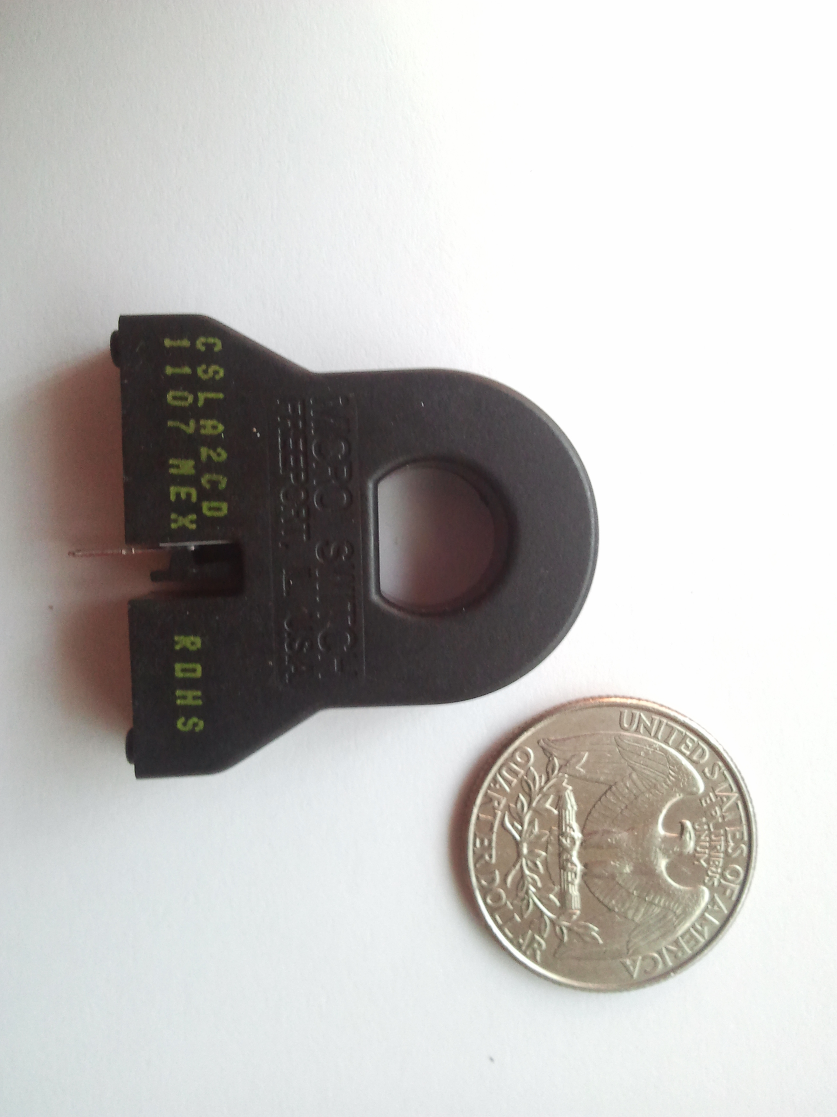
Current Sensing Circuit
Hall Effect current sensors are insensitive to dust, vibration, humidity, cold and hot so their characteristics and measuring sensitivity remain the same thanks to their very well sealed, closed structure.
They don’t get hot because of their inductive structure but not resistive.
Because of their non-mechanical structure they don’t break easily.
High speed and repeatability.
They are logic capable
Honeywell CSLA2CD HECS
SUPPLY VOLTAGE
MIN – 5.4V
TYP – 8V
MAX – 13.2V
SUPPLY CURRENT
TYP – 13mA
MAX – 20mA

Slide 15
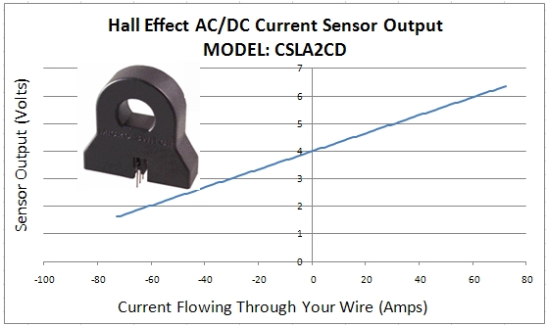
How Hall Effect Current sensor Works
MEASURED CURRENT = [V_{OUT} - 4.0] / 0.033
Notes:
MEASURED CURRENT = [V_{OUT} - 4.0] / 0.033

Slide 16
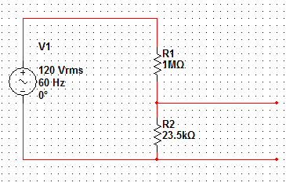
Power Measuring Circuit
For the Power Measuring Circuit all we needed was a voltage divider in order to drop 120 Vrms to 4 VAC so MSP 430 can actually get a sine-wave read

Slide 17


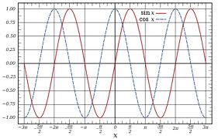
Phase Angle
After collecting measurement from current and voltage measuring circuits, MSP 430 will calculate the phase angle by evaluating the “0” crossings of these two separate sine waves.

Slide 18
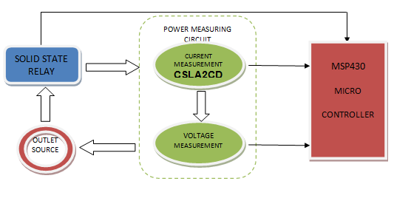
Power Measuring Circuit Blog Diagram

Slide 19
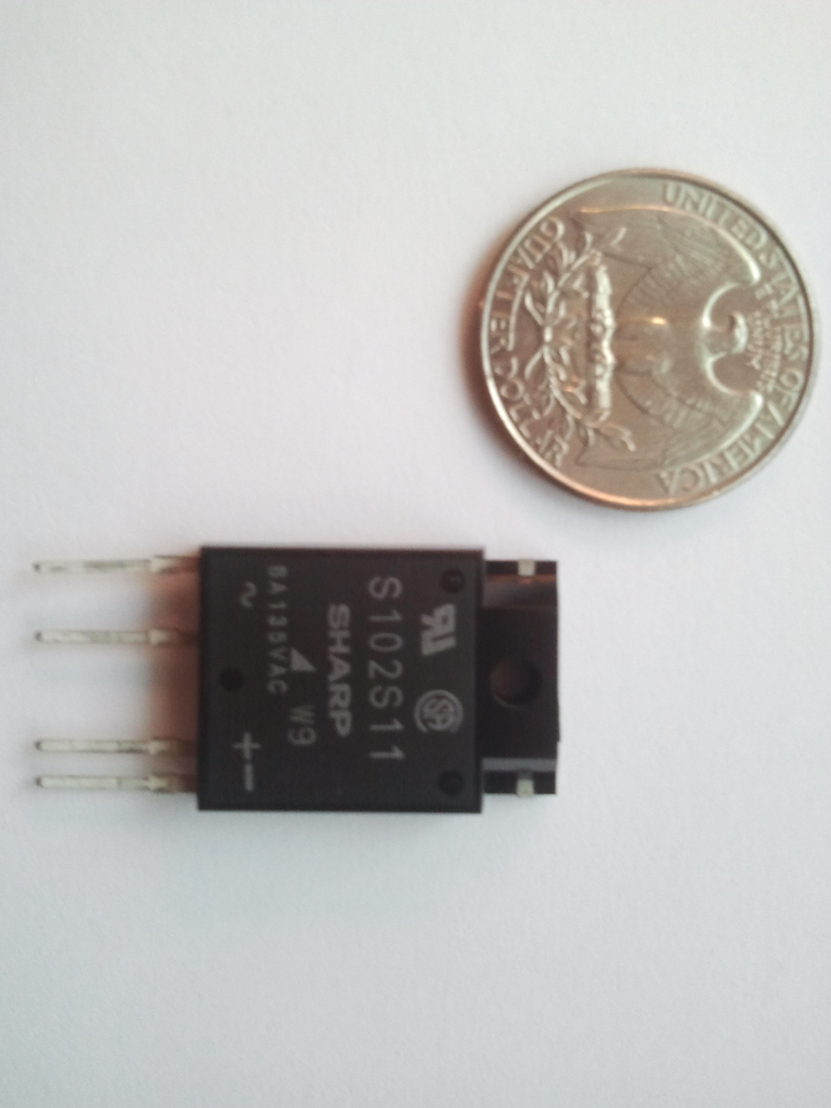
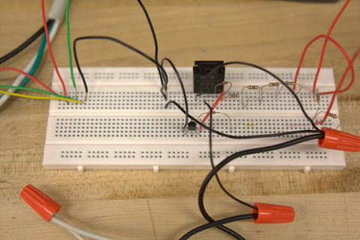
Solid State Relay
We preferred solid state relays against mechanical Because they are smaller, more durable, create less noise, PCB compatible. Overall they are newer and a better technology.
Sharp S102S11 Solid State Relay
INPUT – Low Voltage DC (Switching Relay On)
MIN – 16mA
MAX – 24mA
OUTPUT – High Voltage AC
Load Voltage Min – 80VAC
Load Voltage Max – 125 VAC
Load Current Min – 0.1A
Load Current Max – 16A

Slide 20
CC2500 Wireless Transceiver
CC2500 2.4 GHz, ISM band multi-channel low power transceiver
13.3mA consumption during operation
400nA consumption while in sleep mode
Programmed to transfer data up to 500 kBaud
Voltages between 1.8 and 3.6 volts
On chip antenna
Controlled via SPI interface
SimpliciTI

Slide 21
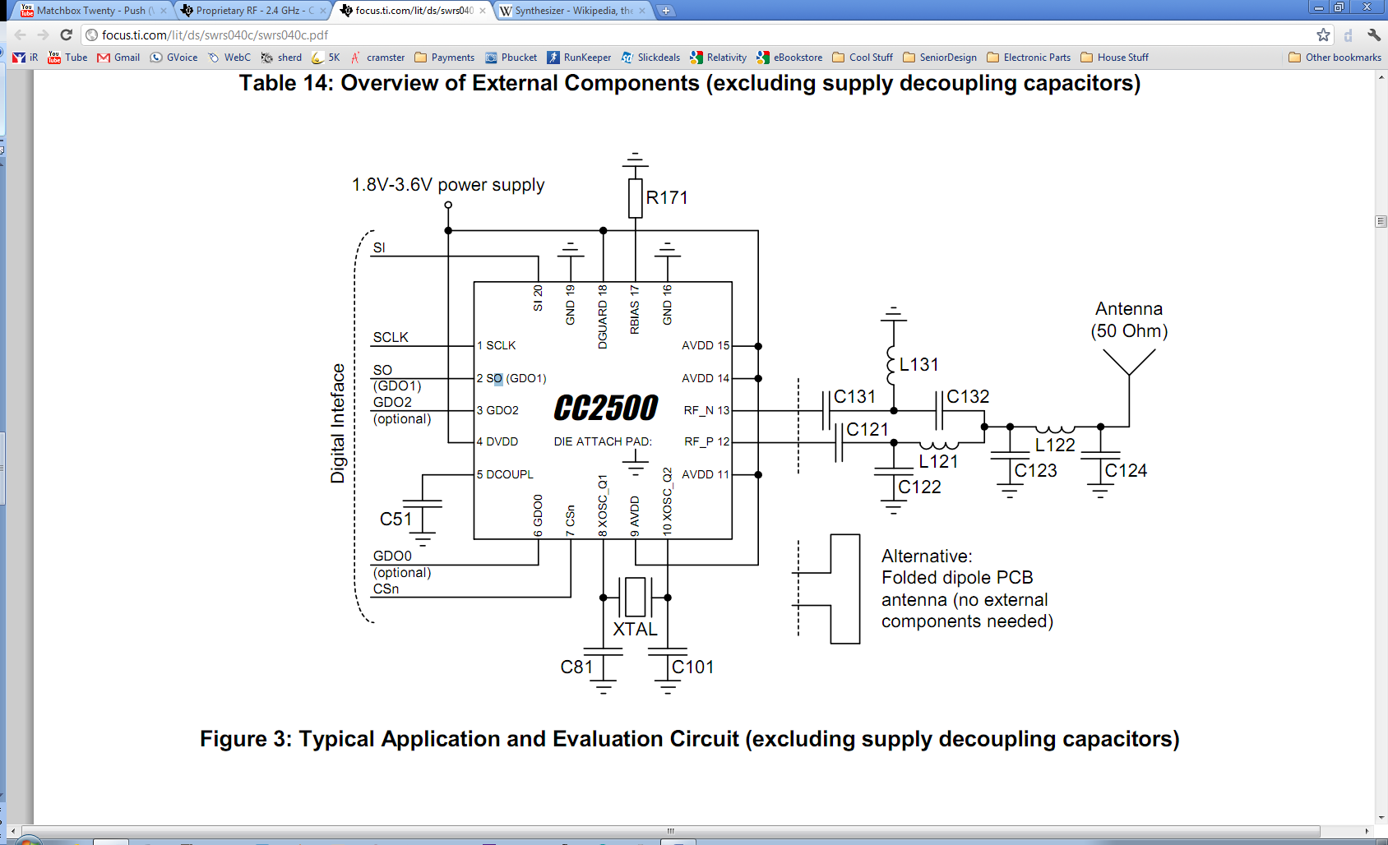
CC2500 Wireless Transceiver

Slide 22
Data Flow
Data Out
CC2500
CC2500
Awake
Control
Data Out
Control
Control
Data Out
Awake
Awake
LOCAL
MSP430
Power Strip
MAIN
MSP430
Control

Slide 23
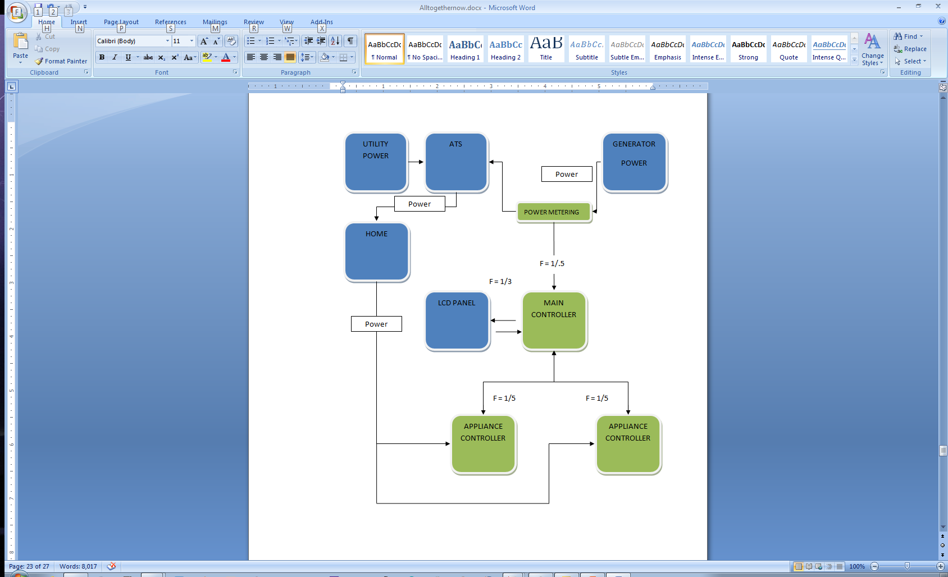
Communication

Slide 24
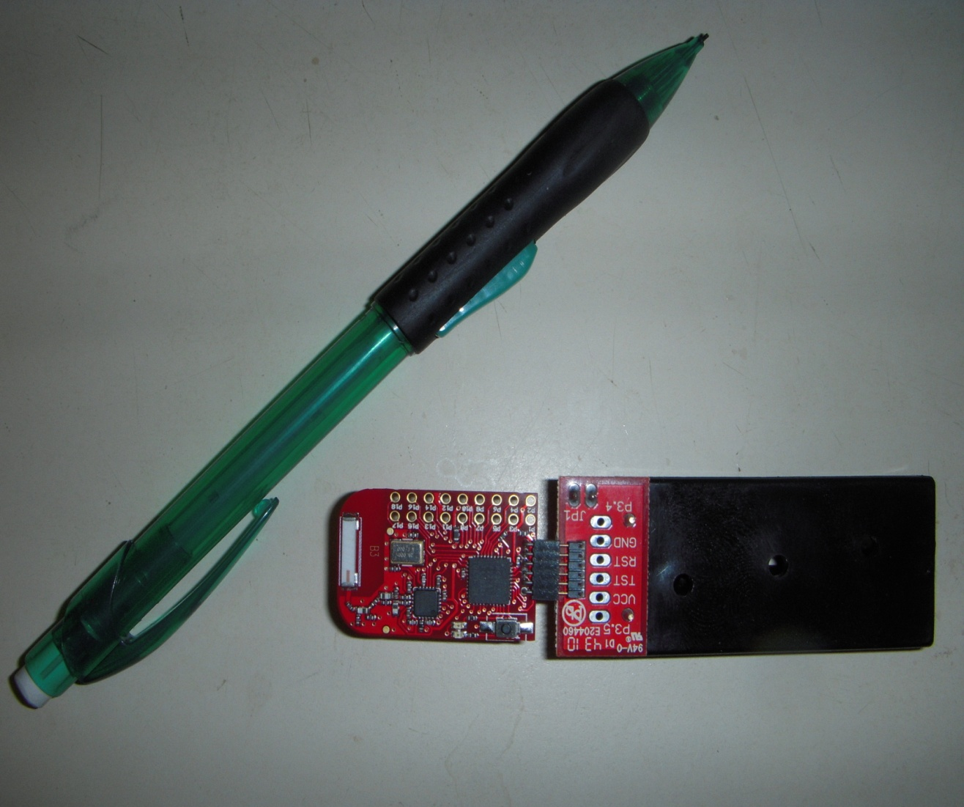
TI eZ430-RF2500
MSP430F2274
CC2500
Examples
ADC10

Slide 25
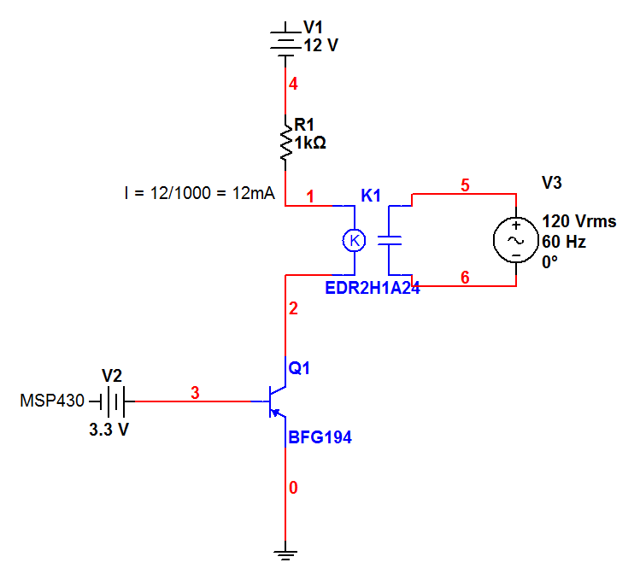
Powering Outlets

Slide 26
A/D Conversion
10 bit analog to digital converter
Set high/low reference voltages
X = 1023*(P8 - Vref- )/( Vref+ / Vref- )
X = 1023*(5/20)
X = 255.75

Slide 27
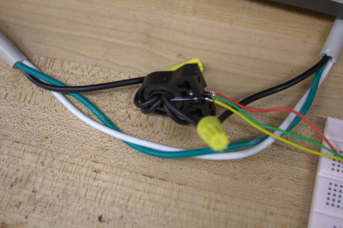
Testing Procedure
Power Sensing Circuit
MSP430
Wireless
LCD
Software
ATS
Scaled Test

Slide 28
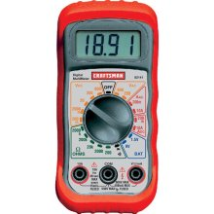
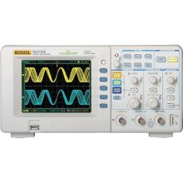
Problem Solving
RMS Value during power measurement
Reset breaker multiple times
Phase angle
Software

Slide 29
Microprocessor Functions
Monitor:
Takes inputs from circuit in power strip module
Measures voltage, current values
Calculator:
Power
Energy (Reactive, active, apparent)
RMS values
Transceiver:
Send calculated circuit values for each outlet
Receive commands from LCD to turn outlets on/off

Slide 30
MSP430
Free microprocessor from TI
Low power
AFE series of MCUs
Built specifically for utility metering
Sample projects, code, and library of functions available on TI’s website
Built-in functions for helping to calculate voltage, current, power, as well as arithmetic operations

Slide 31
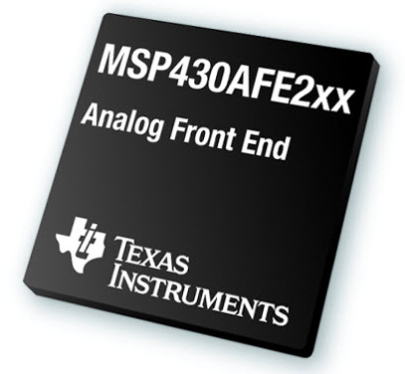
MSP430AFE253 Specifications
Low power consumption
One active mode: 220 µA at 1 MHz, 2.2V
Five standby modes: 0.5 µA
Supply Voltage, V_{cc}: 1.8V to 3.6V
Wakeup from LPMs in < 1µs
16-bit RISC architecture
Two digital I/O ports, with 13 total programmable lines
Three 24-bit Analog-to-digital converters
Size: 7.7 x 6.2 x 1.2 mm

Slide 32
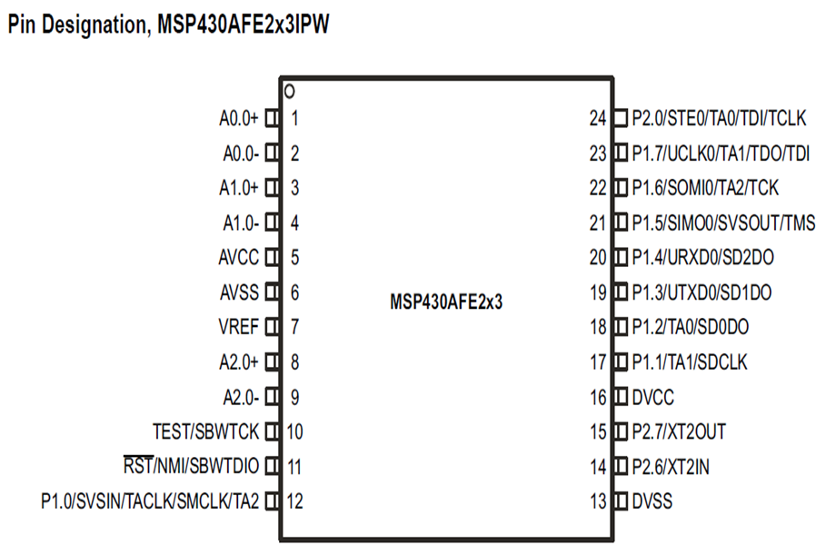
MSP430 Pin assignments

Slide 33
Code Composer Studio (CCSv4)
Alternative to IAR Embedded Workbench
Free program from Texas Instruments
Programs in C/C++
Challenges:
Re-learning C programming (All EE in group)
Understanding MSP430 instruction syntax

Slide 34
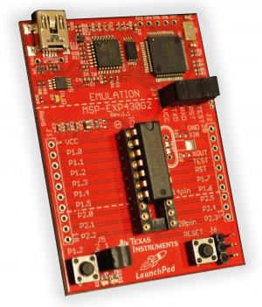
MSP430 Launchpad
Compatible with CCSv4 and IAR embedded workbench
Comes with MSP430G2231
Most coding same as MSP430AFE
Immediately available environment to test and debug code
2kB Flash
USI (I²C, SPI)
8-channel ADC
Tutorials on wiki site
TI
Third parties
Cost: $4.30 (or free)

Slide 35
Pre-built functions
Function name | Action
dc_filter | Filters the DC content from an AC mains waveform signal.
debounce | Used to debounce a push button switch, i.e. eliminates errors associated with pushing a button to activate a clock edge.
div_sh48 | Shifts a 48 bit integer upwards by a specified amount, and then divides a 16 bit integer into the 48 bit integer.
div48 | Divides a 16 bit integer into a 48 bit integer.
imul16 | Completes a 16x16 2’s complement multiplication.
isqrt32 | Computes the square root of a 32 bit number, where the last 16 bits are after the decimal point. NOTE: be careful not to have a negative number as input.
mul48 | Computes a 32x16 multiplication function.
q1_15_mul | Computes a 16x16 multiplication function.

Slide 36
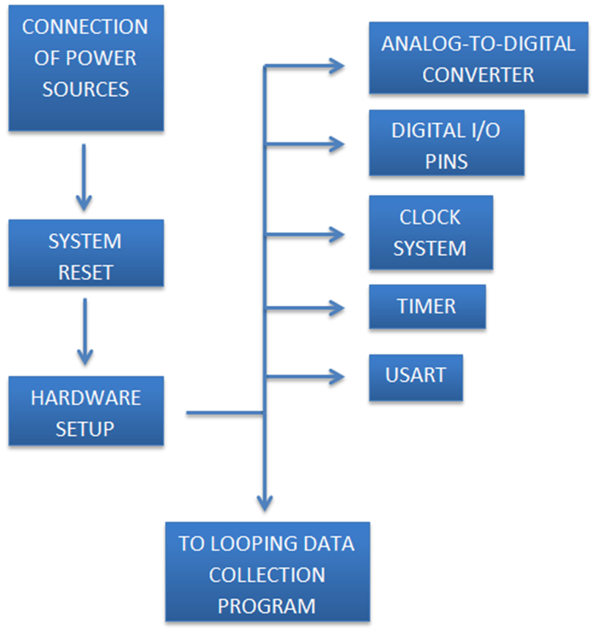
MCU Program Flow (1/2)

Slide 37
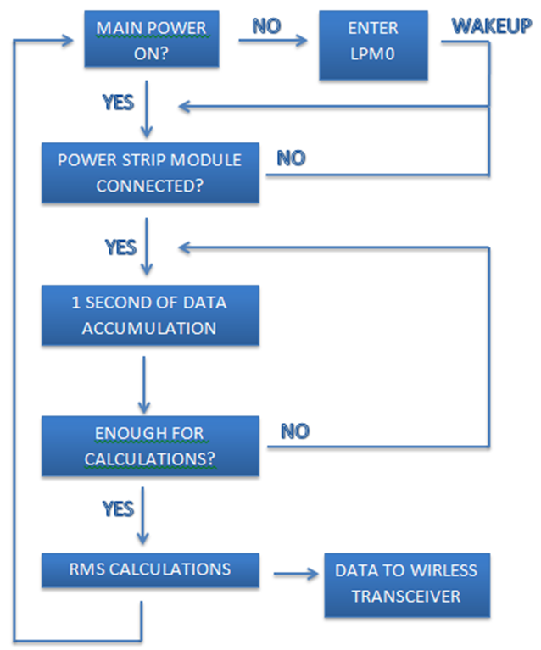
MCU Program Flow (2/2)

Slide 38
Administrative Content

Slide 39
Budget
Part Name | Quantity | Cost | Total
Microcontroller Components | ~ | $20 | $20.00
LCD Display | 1 | $400.00 | $400.00
Automatic Transfer Switch | 1 | Free | Free
Outlet Housing | 1 | $10.00 | $10.00
Current Transformer | 4 | $16.00 | $64.00
MSP430AFE253 | 4 | Free | Free
Initial PCB design | 1 | $30.00 | $30.00
Circuit Board | 4 | $30.00 | $120.00
Solid State Relay | 4 | $8.00 | $32.00
EagleCAD Software | 1 | $49 | $49
Power Outlet | 4 | $10 | $40
Total |  |  | $765.00

Slide 40
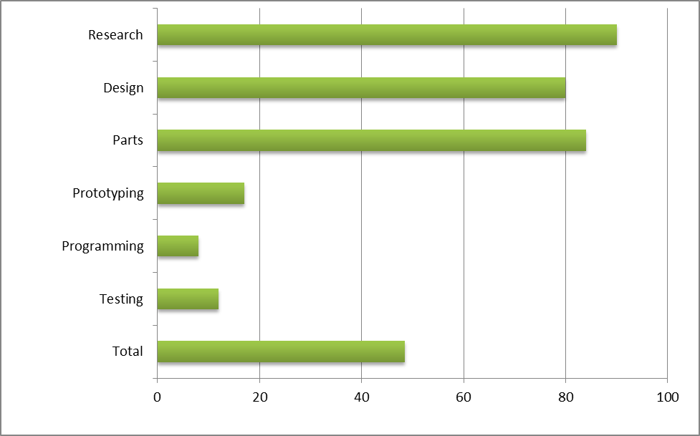
Progress

Slide 41
Future Improvements
We wished to add more programming aspects into the project but we didn’t have a programmer in our group. If we ever have time we would like to get an Android application added to the project. Since as a part of the project we can turn an outlet on and off, we thought it would be nice to turn the AC or the water heater on and off from our cell phones. This way power consumption would be reduced drastically since they can only be on 20 minutes before the user arrives home.

Slide 42
Questions?

